Slide 1
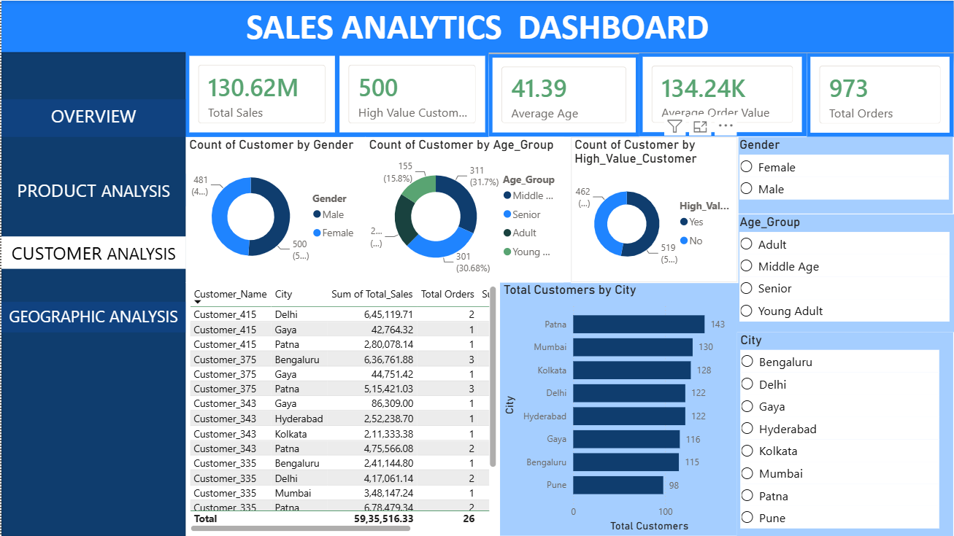
Sales Performance Analytics
Presented by : Nikhil Dutt Anuchuri
Role :Aspiring data analyst
Tools: Excel, SQL, Python,Powerbi

Slide 2
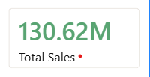
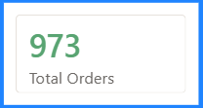
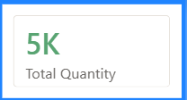
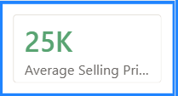
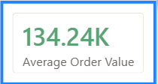
Business Problem
The company lacks a clear understanding of sales performance , customer behavior, and product trends
Objectives :
Analyze overall revenue.
- Identify Electronics (Top Category).
- Identify Patna & Mumbai (Top Cities).
– Study monthly sales trends.
- Understand customer purchasing behavior.
- Build an interactive dashboard.
The company did not have a centralized view of sales performance. My objective was to analyze revenue, identify the best-performing categories and cities, understand customer behavior, and create a dashboard that supports decision-making

Slide 3
Dataset type:-
Item:-
Dataset Type:-
Source:-
Data Tools Used:-
Description
Retail Sales
Company Transaction
Excel, SQL, Python, Power BI
Workflow
Raw Data
Cleaning
SQL Analysis
Python EDA
Power BI Dashboard
→
→
→
→
↓
Insights
“The dataset contains customer, product, order, and sales information. I used SQL and Python for analysis and Power BI for visualization. The workflow moved from raw data to actionable insights.”

Slide 4
Data Cleaning & Preparation:-
Problems Found :-
- Missing values
- Duplicate rows
- Inconsistent date formats
- Incorrect data types
Cleaning Steps
- Removed duplicates.
- Handled missing values.
- Standardized dates.
- Converted columns to correct data types.
- Validated calculations.
Result
✔ Created an analysis-ready dataset.
I removed duplicates, handled missing values, standardized dates, corrected data types, and validated calculations. These steps ensured the dataset was reliable for analysis

Slide 5

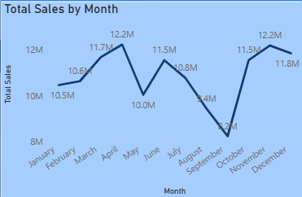
EXPLORATORY DATA ANALYSIS
Total Sales Analysis:-
Total Revenue:- 130.62 MILLION
Number of Orders:-973
Average Order Value :-134.24 THOUSAND
Insight Example:
The business generated ₹13 crores approximately in total sales from 973 orders, indicating strong customer demand and transaction volume.
2.Monthly Sales Trend:-
April and November months had the highest sales.
September month had the lowest sales.
Sales increased from January (10.5M) to April (12.2M).
There was a sharp decline in May (10.0M).
Sales recovered in June (11.5M) but gradually decreased through September (8.2M), which was the lowest month.
A strong rebound occurred in October (11.5M).
Sales peaked again in November (12.2M) before slightly declining in December (11.8M).

Slide 6
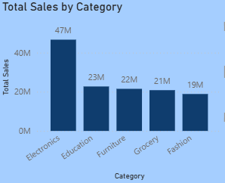
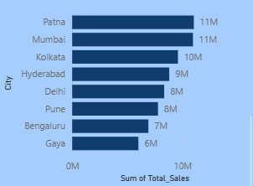
3. Sales by Category:-
Explain:
Electronics generated the highest revenue at 47M, making it the largest contributor to overall sales.
Fashion recorded the lowest sales at 19M, indicating an opportunity to improve product performance and customer engagement.
Electronics accounts for approximately 35.6% of total sales, meaning more than one-third of the company's revenue comes from this category alone.
Key Insight Electronics leads category performance with 47M in sales, contributing about 35.6% of total revenue, while Fashion is the lowest at 19M. However, ANOVA testing (see Statistical Validation) found this gap is not statistically significant, suggesting the difference may reflect normal variability rather than a structural gap between categories.
4.Sales by cities:-
Patna and Mumbai generated the highest sales, with approximately 11M each,
making them the strongest revenue contributors among all cities.
The top three cities contribute nearly 46% of total sales, indicating that revenue is
concentrated in a few high-performing markets.
Gaya and Bengaluru generated comparatively lower sales, suggesting potential opportunities for market expansion, promotional activities, and customer acquisition efforts.
Key Insight:
Patna and Mumbai are the highest-performing cities at 11M each, while the top three cities together contribute nearly 46% of total revenue. This suggests strong demand in major urban markets, whereas cities such as Gaya and Bengaluru offer opportunities for further growth and market development.

Slide 7
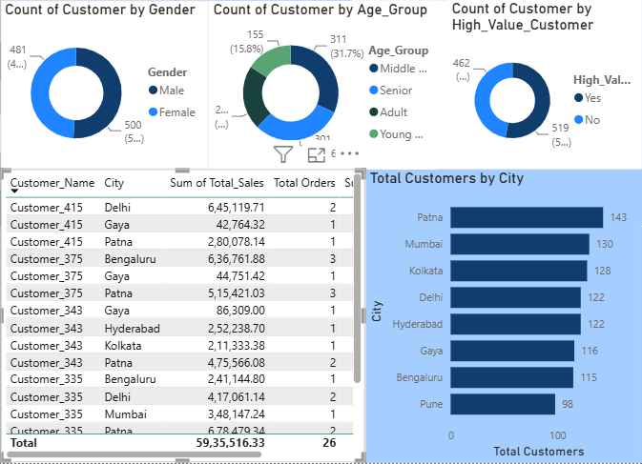
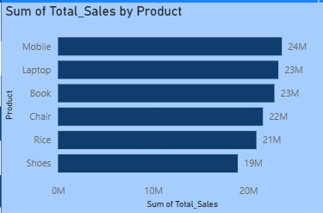
5. Customer Demographics:-
Middle-aged customers form the largest customer
group, accounting for roughly 31% of the customer base,
making them an important target segment for the
business.
The customer base is nearly evenly distributed across
genders, with males contributing about 51% and females
about 49%, indicating broad market appeal.
High-value customers represent the largest customer
segment at approximately 53% of the customer base,
making them a key focus for retention and personalized
marketing strategies.
Key Insight: Middle-aged customers are the largest
customer group (31%), the gender distribution is nearly balanced (51% male vs. 49% female), and high-value customers make up the majority of the customer base (53%), making them a critical segment for customer retention and revenue growth.
6. Top Products:-
Mobile is the best-selling product with 24M in revenue, followed closely by
Laptop and Book at 23M each.
The top three products contribute approximately 53% of total product revenue,
indicating that revenue is concentrated among a few high-performing items.
Key Insight: Mobile is the highest-selling product at 24M, and the top three
products—Mobile, Laptop, and Book—generate approximately 53% of total product revenue. This indicates that a few high-performing products play a major role in driving overall sales

Slide 8
Power BI Dashboard Walkthrough

Slide 9
Key Insights & Findings:-
Top Category:-
Electronics generated the highest revenue. It contributed approximately 35.6% of total category sales, making it the primary revenue driver.
Top City:-
Patna and Mumbai contributed the largest share of sales. Both cities generated about 11M in revenue and were the strongest-performing markets.
Peak Month:-
Sales peaked during April and November. Both months recorded approximately 12.2M in sales, indicating strong seasonal demand.
Top Age Group:-
Middle-aged customers represented the largest customer group.They accounted for roughly 31% of customers and were identified as an important target segment.
Product Concentration:-
A small number of products generated a large share of sales.Mobile, Laptop, and Book together contributed approximately 53% of total product revenue.

Slide 10
Statistical Validation
Test 1: Independent T-Test
Test 2: One-Way ANOVA
OBJECTIVE
OBJECTIVE
Gender vs Sales
Category vs Sales
T-STATISTIC
P-VALUE
F-STATISTIC
P-VALUE
0.4685
0.6395
0.5542
0.6960
Fail to Reject H₀
Fail to Reject H₀
No statistically significant difference in spending between male and female customers.
Average sales do not differ significantly across product categories.

Slide 11
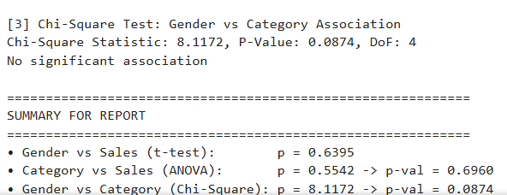
Test 3: Chi-Square Test
Objective
Gender vs Category
Chi-Square 8.1172
P-Value 0.0874
Degrees of Freedom 4
Conclusion :-Fail to reject H₀
No significant association between customer gender and product category selection.
Key Business Insight
Gender: No significant impact on customer spending.
Product Categories: Similar sales performance across categories.
Customer Behavior: Purchasing preferences appear broadly consistent across genders.
Recommendation: Focus on pricing, promotions, customer segmentation, and retention strategies rather than gender-specific marketing.

Slide 12
Business Recommendations:-
Optimize Inventory Management:-
Action
Increase inventory for high-selling products.
Maintain safety stock to avoid stock-outs.
Monitor demand trends regularly.
Focus on High-Revenue Regions:-
Action
Allocate additional marketing budget to Patna and Mumbai.
Expand customer acquisition campaigns in top-performing locations.
Analyze why these regions perform better and replicate successful strategies elsewhere.
Improve Underperforming Categories
Action
Offer targeted discounts and bundles.
Review pricing and product assortment.
Identify categories with declining sales and redesign promotional strategies.

Slide 13
Prepare for Seasonal Demand:-
Action
Increase inventory before peak sales months.
Schedule marketing campaigns ahead of seasonal spikes.
Coordinate procurement and logistics to prevent shortages.
Personalized Customer Marketing:-
Action
Identify high-value customers.
Send personalized offers, loyalty rewards, and recommendations.
Use customer segmentation to improve retention and repeat purchases
Final Recommendation:-
Leverage sales insights to optimize inventory, strengthen top-performing markets, improve weaker categories, and build personalized customer engagement strategies for sustainable growth.
.
Expected Business Impact
Revenue↑ Higher Sales
Retention↑ Better Loyalty
Inventory↓ Stock-Outs
Growth↑ Business Growth

Slide 14
Project Successfully Completed
Project Completion Checklist
Data Collection & Cleaning
Exploratory Data Analysis (EDA)
SQL Queries & Business Analysis
Hypothesis Testing
Interactive Power BI Dashboard
Business Insights & Recommendations
Skills Demonstrated:-
SQL
Python
Pandas
EDA
Statistics
Power BI

Slide 15
Final Takeaway:-
This project demonstrates an end-to-end data analytics workflow:
Cleaned and prepared raw sales data.
Analyzed trends and KPIs using SQL and Python.
Validated business assumptions through hypothesis testing.
Built an interactive Power BI dashboard for decision-making.
Delivered actionable recommendations to improve business performance.
Key Message:
Turning raw data into meaningful insights that support smarter business decisions.
Connect With Me:-
GitHub:-https://github.com/NIkhildutt7674
LinkedIn:-https://www.linkedin.com/in/nikhil-dutt-anuchuri-2b2205393/Email:-anikhildutt@gmail.com

Slide 16
Thank You
Questions & Feedback are Welcome

